Slide 2
Chapter 1: Introduction
Part A: Core Concepts
Part B: The Practicalities
Rationale, Scope and Background of Cultural Risk Assessment and CIERA
Chapter 2:
Chapter 8:
Cultural Risk Assessment & The Cultural Inclusivity and Equity Risk Assessment (CIERA)
Chapter 3: Cultural Risk – EEDI and Bias
Activating Theory -
England and Wales Cricket Board
Chapter 9:
Chapter 4: The Science of Inclusion and Bias
Managing Organisational Risk: Integrating Cultural Risk Awareness into Corporate Governance
Chapter 10:
Chapter 5: Culture
Chapter 11:
Comparing faith in cultural contexts: In Sacred Spaces and on the Dancefloor
Chapter 6: Theories and Frameworks
Chapter 12:
Activating Theory - Action Research with Faith Leaders for the British Ritual Innovation in COVID
Chapter 7: Cultural Intelligence (CQ)
Chapter 13:
Between the lines -
Conversations in Context, a Dialogical Approach
Part C: Case Studies
CS 1: Sweden – Religious Heritage
CS 10: UK – Faith and Sexuality
CS 2: UK – Sensory Rooms
CS 6: Qatar – Football World Cup
CS 11: UK – Cultural Events
CS 3: England – Prom Events
CS 7: USA – NFL
CS 12: USA – Belonging and Ethnicity
CS 4: UAE – Cultural Awareness
CS 8: Japan – Cultural Heritage
CS 13: Caribbean – Diaspora Communities
CS 5: Australia – Indigenous Communities
CS 9: UK – Sport and Gender
CS 14: Nigeria – Business Events

Slide 3
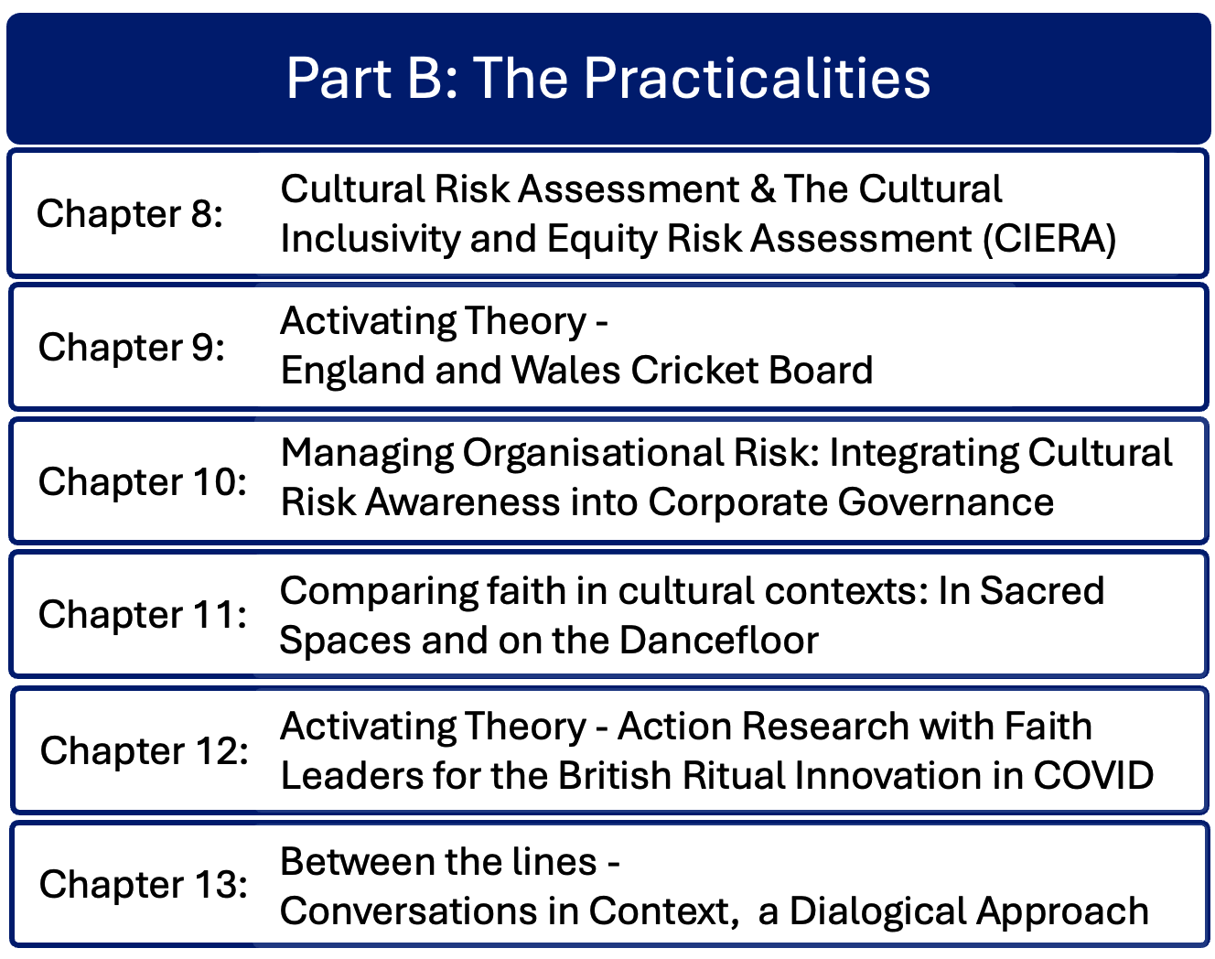

Slide 4
Chapter 9: Activating theory – England and Wales Cricket Board
Ruth Dowson & Bernadette Albert
A 2022 research project for the England and Wales Cricket Board (ECB) to review cricket events and venues, assessing cultural risks and proposing mitigating actions.
Applied classroom theory to professional practice visiting 4 English county cricket stadia, analysing them as venues
Aimed to support cricket event organizers and venue managers in creating inclusive environments to encourage greater diversity for sports teams, other staff, volunteer teams, and attendees.
Recommended consistent training and communication among staff, and strategic leadership in EDI

Slide 5
Introduction
2022 research project Leed by Leeds Beckett University for the England & Wales Cricket Board
Utilised authors’ cultural capital, professional events and venue expertise
Assessed cultural risks of 4 county cricket grounds to propose mitigating actions
Activated Cultural Risk Assessment theory developed in the classroom
Enhanced understanding of developing more inclusive event spaces
Introduced new elements for cultural risk analysis

Slide 6
England & Wales Cricket Board (ECB) Venue Visits
ECB selected county cricket stadia for visits on match days
Aim of creating more diverse workplaces, including cricket teams; and encouraging more diverse match attendees
Consultants: experienced venue and event management professionals, with academic expertise
Prepared tailored reports for each individual venue
Complexity of sports events venues: employees include players, freelancers and suppliers
Assessed characteristics through observations, identified good practice and areas for development
Adequate briefings needed for all staff

Slide 7
Strategic aspects
Evidence of strategic leadership in EDI
Evidence for organisational commitment
Organisation cultures assessed for transformation
Encouraged sharing of good practice
Encouraged venues to diversify representation across all protected characteristics
Observed training and communications briefings
Mapped spectator journeys
Embedding sustainability throughout the organisation

Slide 8
Key elements 1
Race, ethnicity, nationality: workforce ‘diversity’ may be concentrated in some roles / areas of the organisation. Introduce social cohesion initiatives
Sexuality, gender, reassignment: special projects to encourage girls and minority ethnic youth, LGBTQ+
Disability and neurodiversity: websites, apps and site plans should clearly identify locations of all specialist facilities, with staff trained to direct attendees. Offer wristbanding for non-visible disabilities
Social class, economic background, financial status, educational background: introduction of programmes to engage with diverse local communities and schools

Slide 9
Key elements 2
Age: programmes with local schools, family-friendly activities and menus. Consider impacts of cashless venues on older people / those not familiar with technology
Catering, bars, hospitality: online hospitality options to cover diversity, religious requirements, allergies. Ensure all food concessions abide by nuanced catering requirements (e.g. separation of meat / non-meat, halal, gluten-free foods
Alcohol: take into account impact on diverse audiences of heavy alcohol consumption and the need for cultural or medical abstinence
Visual barometer: show authentic diversity
Site layout including entrances: cleanliness, signage. Prioritise safety

Slide 10
Key elements 3
Booking systems and apps: introduce facility that captures and retains individual customer detailed requirements on registration
Language and behaviour, dress: separate zones for fancy dress, introduce spectator codes of conduct. Welcome in multiple languages
Smoking and vaping: learn from successful non-smoking sites
Weather: Hydration stations, shade under cover especially for families
Family-friendly: baby-changing and nursing facilities

Slide 11
Impact on CIERA©
Spaces feel more inclusive for people with diverse characteristics if there are people who look like them at all levels of the organisation, if there is food they can eat and if there are toilets they can use
Reputational risk of failure to enhance diversity
CIERA© grew from onsite research that built on classroom experience
CRA process makes provision for cultural diversity; to transform spaces requires intentionality and collaborative working, enhanced by external partnerships

Slide 12
Summary
Visited four county cricket stadia on match days and non-match days
Assessed cultural risk elements of physical structure, site and internal building layout, staff experiences and engagement
New and traditional facilities

Slide 13
Discussion Questions
What aspects of cultural risk most surprised you in this study?
How could organizations such as ACE contribute to event managers undertaking a cultural risk assessment?
What learning can you take from cricket and apply to other sports?
What learning can you take from sport and apply it to another type of event?
From an event or venue of your choice that you know well, apply the cultural risk elements as listed in the cricket case study and draw up an action plan.
Identify one additional cultural risk that impacts on an aspect of managing an event.
If you were assessing a potential venue for an event you were running, how would you approach the venue site visit using the Cultural Risk Assessment approach?

